Slide 1
THARAKA UNIVERSITY SEMINAR
Pedagogy Training –Teaching methodologies in higher education by:
Charity Limboro (PhD)
Kenyatta University
15-16th February 2022

Slide 2
WHAT IS PEDAGOGY?
According to Merriam-Webster, pedagogy is the “art, science, or profession of teaching.” This broad definition covers various aspects of teaching, and there are many moving parts to pedagogy that include course design teaching styles, feedback, and assessment.
Why pedagogy in higher education?
Many teachers at higher education are not trained in the art of teaching
Majority of college teachers do not seem to have learning goals that go much beyond an understand and- remember type of learning
Research evidence shows that teachers rarely ask even a single question in a one-hour class
In-depth, sustained discussions where students respond to other students as well as to the teacher are extremely rare.

Slide 3
WHY PEDAGOGY IN HIGHER EDUCATION CONT.D?
Increased demand for higher institutions of learning to provide quality and effective student learning experiences
Requirement from CUE to increase and improve faculty development across all levels, particularly in the area of teaching and learning
Moreover, efforts to train students in professional and technical skills, as well as the employability skills (such as critical thinking, communication, collaboration (working in teams) and problem solving) requires a paradigm shift among faculty members.

Slide 4
Society is undergoing a fundamental transformation from the Industrial Age to the Information Age. (Dolence and Norris, 1995).
Due to technological advancement traditional institutions have lost their “exclusive franchise,” that is, their monopoly on providing post secondary learning.
We now have new distance or virtual learning –flexible and cost effective

Slide 5
Traditional universities are insufficiently flexible, they focus on processes and outputs (graduates) rather than on outcomes (significant learning), and they operate in a way that generates high cost (Dolence and Norris, 1995, p. 11).
If the new vendors succeed in unbundling the degree package and offering students a high quality
Learning experience focused on what learners need and want, offering certification of that learning, and doing so at greater convenience or lower cost, or both—they will attract a significant amount of enrollment away from traditional universities

Slide 6
New providers who are competing effectively for students
This combination of new providers and new modes of delivering educational services is leading to the third force for change: the globalization of higher education.
Educational institutions globally are marketing and offering their courses and degree programs worldwide.
Consequently, the need to strengthen faculty skills and enthusiasm for teaching has gained prominence over the recent past.

Slide 7
In the last three decades higher education institution have embraced a paradigm shift in which institutions are thinking less about providing instruction (the teaching paradigm) and more about producing learning (the learning paradigm –active learning (Barr and Tagg, 1995).
Faculty members are not likely to make the decision to change without support from their institutions.
In order to learn new ways of teaching: time, encouragement, institutional centers that can provide the ideas that faculty need, reward, and so on.

Slide 8
This presentation will focus on:
Preparation, Behavioral aspects, Teaching content & other materials

Slide 9
PREPARATION TO TEACH IN HIGHER EDUCATION
This process includes several aspects: designing or revising your course, the type of class you are teaching (large class or small), understanding who your students are, understanding academic integrity policies and practices, and developing productive faculty working relationships.
In order to teach well, one must be competent in both course design and teacher-student interactions.
Our ability to design courses well is usually the most limiting factor. Why?
Research on teaching in higher and learning have led to some new ideas about course design that have, in essence, “raised the bar” in terms of what is possible (Fink, 2003).

Slide 10
These include ideas such as active learning, significant learning, and educative assessment.
A self-Directed Guide by Fink (2003) is deemed as an appropriate guide to course design. The framework is categorised into 3 phase (Initial intermediate and final design phases) that have been widely used.

Slide 11
INITIAL DESIGN PHASE: BUILD STRONG PRIMARY COMPONENTS
Step 1. Identify important situational factors - how many students are in the course, students & teacher characteristics, nature of the subject, what kind of prior knowledge).
Step 2. Identify important learning goals (what you want students to get out of the course. What is important for them to learn and retain, 2-3 years after the course is over? What kind of thinking or application abilities do you want them to develop?
Step 3. Formulate appropriate feedback and assessment procedures (What will students do to demonstrate they have achieved the Learning Goals we set for the course?)
Step 4. Select effective teaching/learning activities(Use “Active Learning” activities’’ this entails
  “Rich Learning Experiences” experiences in which students achieve several kinds of significant learning simultaneously
  “In-depth Reflective Dialogue” opportunities for students to think and reflect on what they are learning, how they are learning, and the significance of what they are learning.

Slide 12
Step 5. Make sure the primary components are integrated Are the learning activities consistent with all the learning goals? Are the feedback and assessment activities consistent with the learning goals and the learning activities? Ensure that the key components (Steps 1-4) are all consistent with, and support each other.

Slide 13
INTERMEDIATE DESIGN PHASE: ASSEMBLE THE COMPONENTS INTO A COHERENT WHOLE
Step 6. Create a thematic structure for the course
Step 7. Select or create an instructional strategy
Step 8. Integrate the course structure and the instructional strategy to create an overall scheme of learning activities

Slide 14
FINAL DESIGN PHASE: FINISH IMPORTANT REMAINING TASKS
Step 9. Develop the grading system
Step 10. De-Bug possible problems
Step 11. Write the course syllabus
Step 12. Plan an evaluation of the course and of your teaching

Slide 15
PREPARATION CONT.
Step 2. Learning Goals What do you want students to learn by the end of the course that will still be with them several years later?
Majority of the faculty take a content-centered approach:“students to learn about topic X, topic Y, and topic Z.”
This approach leads to over emphasis on “understand and remember” kinds of learning.
Instead Ask yourself “What would I like the impact of this course to be on students, 2-3 years after the course is over? What would distinguish students who have taken this course from students who have not?”

Slide 16
The emphasize is such things as critical thinking, learning how to creatively use knowledge from the course, learning to solve real-world problems, changing the way students think about themselves and others, realizing the importance of life-long learning, etc.
Fink (2003) Taxonomy of significant learning can used to guide drafting of learning goals for your course.

Slide 17
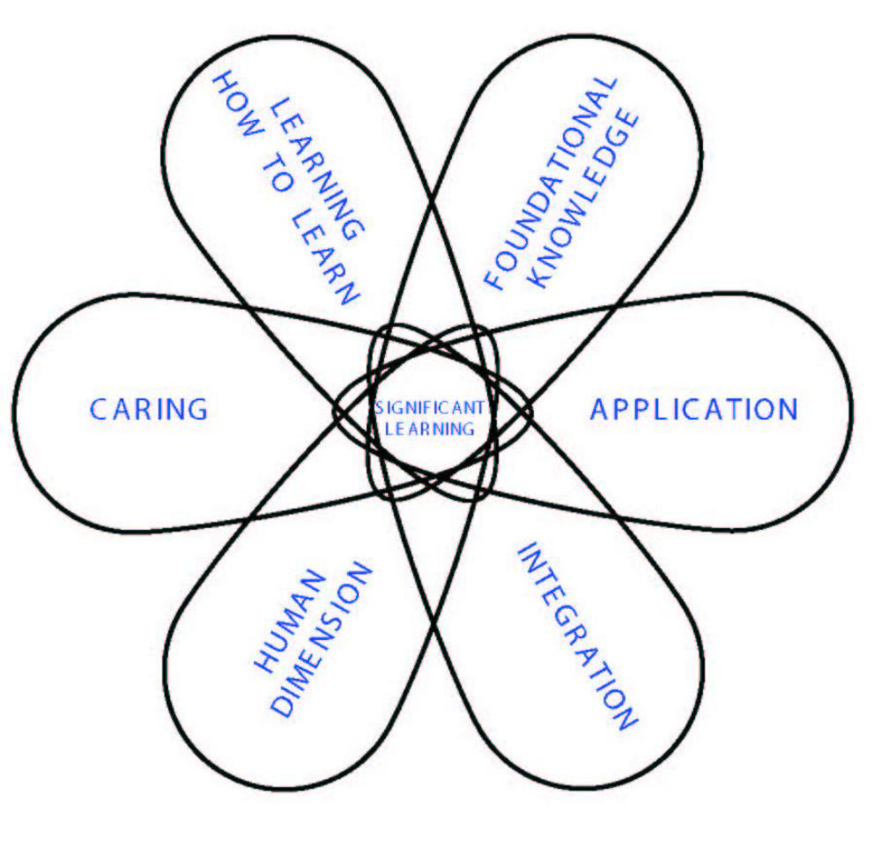
A TAXONOMY OF SIGNIFICANT LEARNING BY FINK (2003)

Slide 18
QUESTIONS FOR FORMULATING SIGNIFICANT LEARNING GOALS
"A year (or more) after this course is over, I want and hope that students will .”
Foundational knowledge
What key information (e.g., facts, terms, formulae, concepts, principles, relationships, etc.) is/are important for students to understand and remember in the future?
What key ideas (or perspectives) are important for students to understand in this course?

Slide 19
APPLICATION GOALS
What kinds of thinking are important for students to learn?
Critical thinking, in which students analyze and evaluate
Creative thinking, in which students imagine and create
Practical thinking, in which students solve problems and make decisions
What important skills do students need to gain?

Slide 20
INTEGRATION GOALS
What connections (similarities and interactions) should students recognize and make).
Among ideas within this course?
Among the information, ideas, and perspectives in this course and those in other courses or areas?
Among material in this course and the students' own personal, social, and/or work life?

Slide 21
HUMAN DIMENSIONS GOALS
What could or should students learn about themselves?
What could or should students learn about understanding others and/or interacting with them?
Caring Goals
What changes/values do you hope students will adopt?
Feelings? Interests? Ideas?

Slide 22
"LEARNING-HOW-TO-LEARN" GOALS
What would you like for students to learn about:
how to be good students in a course like this?
how to learn about this particular subject?
how to become a self-directed learner of this subject, i.e., having a learning agenda of what they need/want to learn, and a plan for learning it?

Slide 23
STEP 3: FEEDBACK AND ASSESSMENT PROCEDURES
In a content-centered course, two assessment (CAT) and end of the semester exams are usually considered sufficient feedback and assessment for the teacher to determine whether the students “got it” or not.
But a learning-centered course requires an assessment procedures collectively known as “educative assessment” to enhance the quality of student learning.

Slide 24
FOUR KEY COMPONENTS OF EDUCATIVE ASSESSMENT
i. Forward-Looking Assessment – Ask questions, and/or problems that create a real-life context for a given issue, problem, or decision to be addressed.
The problem also should be somewhat open-ended and not totally pre-structured. Eg ask students to imagine a situation where they could actually use what they have learned.
ii. Teachers should explain clearly the criteria and standards that will be used to assess student work.
What are characteristics of high quality work in this area?” How good does the work have to be, to be acceptably good or exceptionally good? The answers to these questions reveal the teacher’s standards.

Slide 25
iii. Self-assessment: Later in life, students will need to assess their own performance, and they should start learning how to do that while in the course.
What opportunities can you create for students to engage in self-assessment of their performance?
Let the students generate—and perhaps discuss—appropriate criteria for evaluating and assessing their own work.

Slide 26
FEEDBACK
High quality feedback will have the characteristics of “FIDeLity” feedback:
  Frequent: Give feedback daily, weekly, or as frequently as possible.
  Immediate: Get the feedback to students as soon as possible.
  Discriminating: Make clear what the difference is between poor, average, good and exceptional work.
  Loving: Be empathetic in the way you deliver your feedback.

Slide 27
STEP 4. TEACHING/LEARNING ACTIVITIES
Traditional methods of “lectures have been extensively used –this promotes rote learning
In the 21st century we need to incorporate more ‘active learning’ into our courses. What do we mean by active learning?
Bonwell and Eison (1991) describe active learning as “[involving] students in doing things and thinking about the things they are doing.” By “doing things,” they are referring to activities such as debates, simulations, guided design, small group problem solving, case studies, etc.

Slide 28
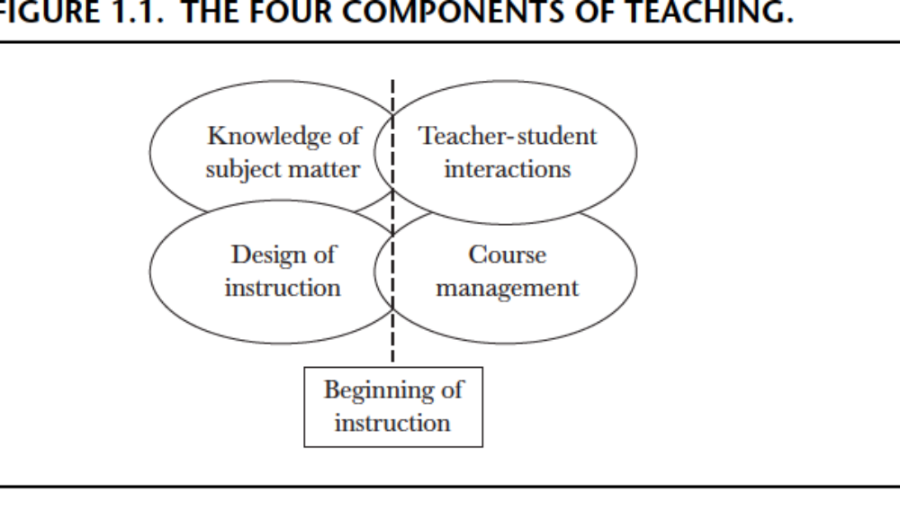
WHAT C0NSTITUES GOOD TEACHING?

Slide 29
This view implies that teachers who want to improve their teaching can do so by improving their competence in one or more of these four aspects of teaching.
Notably faculty members have a good command of their subject matter, thanks to that being the dominant focus in graduate school and in the faculty selection procedures at most institutions
However, overall, knowledge of subject matter
is not a major bottleneck to better teaching and learning in higher education.

Slide 30
‘Teacher-student interactions’-lecturing, leading class discussions, meeting with individual students during office hours, running labs, advising, communicating by e-mail, and so on. This aspect of teaching, by my observation, is a skill that runs the full scale from poor to excellent.
‘’Course management” - having assignments ready when they are needed, grading and returning exams promptly, having grade information ready when a student requests it, and so on.
Design of instruction,” - a skill for which few college level
teachers have been trained. Faculty members simply follow the traditional ways of teaching in their particular discipline.
They lack the conceptual tools they need to significantly rethink and reconstruct the set of teaching and learning activities they use.

Slide 31
RELEVANT TEACHING APPROACHES
Role-Playing, Simulation, Debate, and Case Studies. together they offer students an experience that has significant psychological and social as well as intellectual dimensions. In any case they provide a clear alternative to teaching
as “dispensing information” (Bonwell and Eison, 1991).
Writing to Learn. The whole writing-across-the-curriculum effort made the argument that writing activities can also enhance the process and quality of student learning (Zinsser, 1988; Bean, 1996).

Slide 32
Small Group Learning. small groups can create powerful kinds of learning—about the subject, the problem-solving process, oneself, working with others, cross-cultural awareness, and so on (Johnson, Johnson, and Smith, 1991; Millis and Cottell,1998; Michaelsen, Knight, and Fink, 2002).
Assessment as Learning. Feedback, usually ungraded, is provided frequently so students can enhance the quality of their learning and teachers can assess the effectiveness of different teaching and learning techniques and strategies (Angelo and Cross, 1993).
Problem-Based Learning. Evidence indicates that students learn how to analyze and solve problems much more effectively compared to learning facts (Wilkerson and Gijselaers, 1996; Duch, Groh, and Allen, 2001).
Service Learning. By adding an experience component that involves both service to others and a chance to observe significant community problems or issues, students add a whole new dimension of quality to their learning ( Jacoby, 1996; Rhoads and Howard, 1998; Zlotkowski, 1998).
Online learning –putting learning materials online on a CD-ROM or website –provides learning on demand among other benefits.

Slide 33
Get Students to Prepare Before Class
NB. Set aside consultation office hours with your students
END OF PRESENTATION. THANK YOU FOR LISTERNING.

Slide 34
DELIVERY APPROACHES (PEDAGOGY/ANDRAGOGY)
-TEACHING POST GRADUATE STUDENTS
Andragogy refers to the methods and approaches used in adult education and is directed towards self-actualization, gaining experience, and problem-solving. In contrast, pedagogy is an education method in which the learner is dependent on the teacher for guidance, evaluation, and acquisition of knowledge
Summary: Andragogy refers to a theory of adult learning that details some of the ways in which adults learn differently than children. For example, adults tend to be more self-directed, internally motivated, and ready to learn

Slide 35
PRINCIPLES GUIDING ADULT LEARNING CONT.D
Adult Learning Is Andragogy, Not Pedagogy Andragogy, a term popularized by Malcolm Knowles (1988), refers to the art and science of teaching adults.
Adult Learners Are Pressed for Time: demanding jobs, family responsibilities, and community commitments.
Adult Learners Are Goal Oriented: It may be work related, such as using a computer more effectively, or personal interests.
Adult Learners Bring Previous Knowledge and Experience When possible, linking new material in a course to learners’ existing knowledge and experience creates a powerful and relevant learning experience.

Slide 36
5. Adult Learners Have a Finite Interest in Types of Information. Although many training courses tackle complex topics, most learners are primarily interested in aspects of the content that affect them directly.
6. Adult Learners Have Different Motivation Levels. As they become more familiar with the content, learners’ motivation to learn may wane until a specific need arises.
7. Adult Learners Have Different Learning Styles Learning style refers to how a person prefers to pick up new content. Each person has a number of preferred learning styles.

Slide 37
Some best practices for teaching graduate students are very similar to those for teaching undergraduates:
Establish learning goals.
Provide frequent feedback.
Incorporate discussions to allow students to build on their expertise.
NB. However, you need to conversant with how undergraduate and graduate students learn

Slide 38
Children | Adults
Child-oriented learning provides a basic foundation of knowledge and helps develop critical thinking skills. | Adults have an existing base of knowledge and life experience. They seek out continuous learning based on personal interests, wants, and needs.
Children typically have no choice but to study and may lose enthusiasm if they are not engaged in what is happening around them. | Adults understand why they’re learning, so their motivation levels are naturally high.
It’s necessary to be in charge of the classroom. | It’s beneficial to let adults work things out for themselves and organize themselves.
Teachers play a central role in delivering knowledge and guiding learning activities. | The role of “teacher” may be effectively filled by a mentor, coach, peer, or expert.

Slide 39
TEACHING STRATEGIES FOR ADULT LEARNERS
Experiential Learning.
Direct Instruction.
Indirect Instruction.
Interactive Instruction.
Independent Study.

Slide 40
EXPERIENTIAL LEARNING
Experiential learning activities to include:
Field trips.
Art projects.
Science experiments.
Role playing.
Reflection and journaling.
Internship opportunities.
Interactive classroom games.

Slide 41
DIRECT INSTRUCTION
Direct instruction is where teachers use explicit teaching techniques to teach a specific skill to their students. This type of instruction is teacher-directed:
Announcements.
Module/Unit introductions.
Descriptions/modeling of assignments and learning activities.
Written or video lectures.
Demonstration videos.
Presentations.
Discussions moderated by instructors.
Interactive tutorials

Slide 42
INDIRECT INSTRUCTION
Indirect instruction is an approach to teaching and learning in which concepts, patterns and abstractions are taught in the context of strategies that emphasize concept learning, inquiry learning and problem-centered learning.
Completion of readings.
Completion of projects, papers, and presentations.
Interacting with peers in online discussions.
Interpretation of data.
Virtual study groups.
Group projects.
Simulations.

Slide 43
INTERACTIVE INSTRUCTION
What is interactive instructional strategy?
Interactive instruction is when students learn through social interaction. Examples of interactive instruction include: Brainstorming, group discussion, question-and-answer sessions, debates and tutoring (peer learning).
Applying interactive education
Encourage student participation.
Use questions that stimulate response, discussion, and a hands-on experience.
Use teaching aids that press for answers, and capture/hold the student's attention.
Set up a workgroup environment.
Involve yourself as well as the studen

Slide 44
INDEPENDENT INSTRUCTION
Independent instructional approach takes the students as the center focus of learning and the teacher is limited in the process.
The student is left to learn the material on their own and given only guidelines from the teacher.

Slide 45
END OF PRESENTATION
THANK YOU

